Slide 1
Last week we looked at NoSQL. Let’s dig into it again in more detail.

Slide 2
WHY NoSQL?

Slide 3
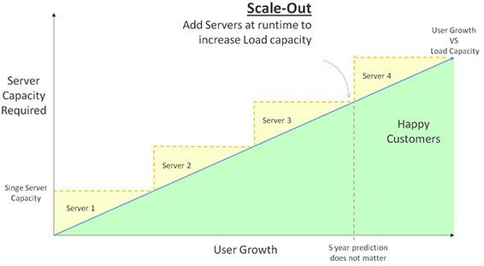
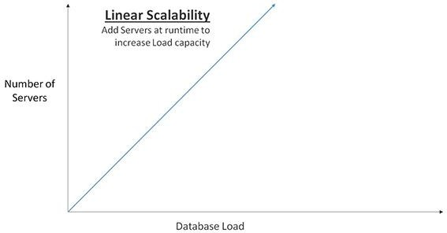
Distributed Mindset

Slide 4
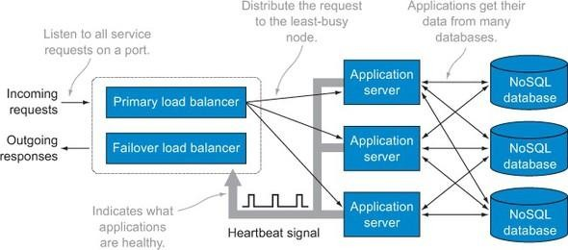
High Availability

Slide 5
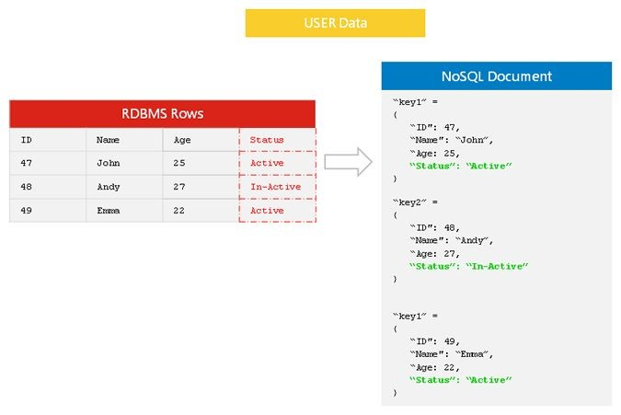
Flexible Data Models

Slide 6
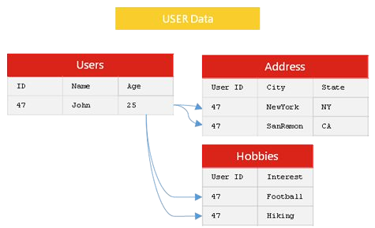
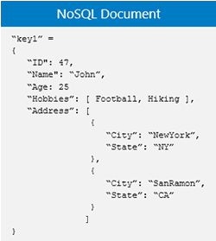
JSON

Slide 7
Aggregation Pipeline
Collection
$project
$match
$group
$sort
Result
Pipeline - series of stages

Slide 8
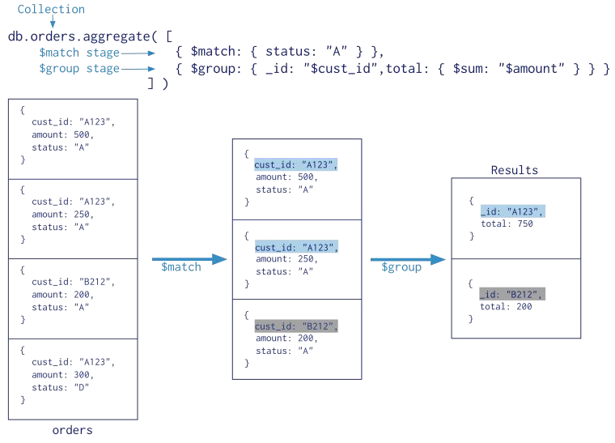

Slide 9
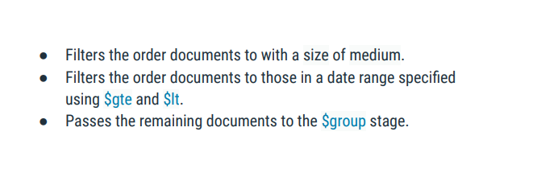
$match

Slide 10
$group
Groups the remaining documents by any ﬁeld.
Can use $sum to calculate the total for speciﬁc set of data. The total thus obtained is stored and returned by the aggregation pipeline.
Groups the documents by date using $dateToString.
For each group, calculates:
Total order value using $sum and $multiply.
Average order quantity using $avg.
Passes the grouped documents to the $sort stage.

Slide 11
$sort
Sorts the documents by the total order value for each group in descending order (-1).
Returns the sorted documents.
For other operators: https://docs.mongodb.com/manual/meta/aggregation-quick-reference/# std-label-aggregation-expressions

Slide 12
Nested Documents

Slide 13

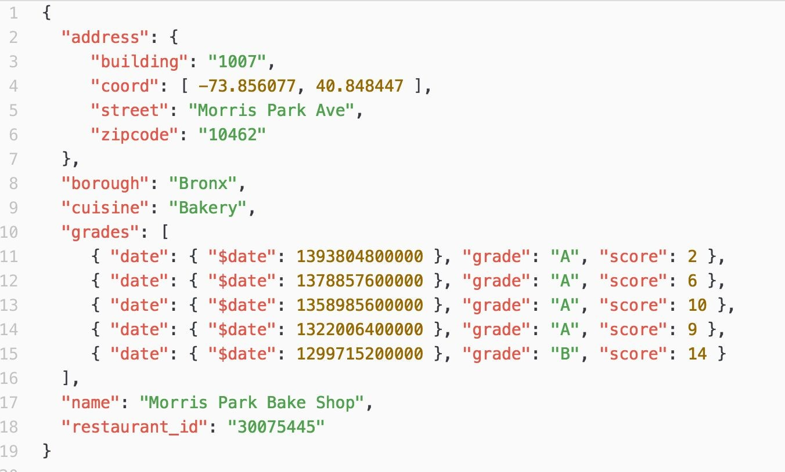
Example of Nested Document

Slide 14
Data retrieval on Nested Document
Operators used to retrieve data on Nested Document:
ﬁnd()
$elematch()
$ﬁlter
Notes: Usage of these operators will be discussed more in detail in Workshop

Slide 15
Pattern Matching
The format for regular expressions is:
{ <ﬁeld>: /pattern/<options> } Or can use the $regex command:
{ <ﬁeld>: { $regex: /pattern/, $options: '<options>' } }
{ <ﬁeld>: { $regex: 'pattern', $options: '<options>' } }
{ <ﬁeld>: { $regex: /pattern/<options> } }

Slide 16
$regex
Few $options are available for using regular expressions such as:
Option | Description
i | Case insensitivity to match upper and lower cases
m | For patterns that include anchors (i.e. ^ for the start, $ for the end), match at the beginning or end of each line for strings with multiline values.
x | "Extended" capability to ignore all white space characters in the $regex pattern unless escaped or included in a character class.
s | Allows the dot character (i.e. .) to match all characters including newline characters.

Slide 17
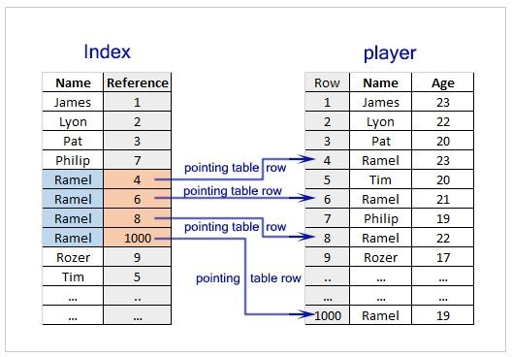
Indexes

Slide 18
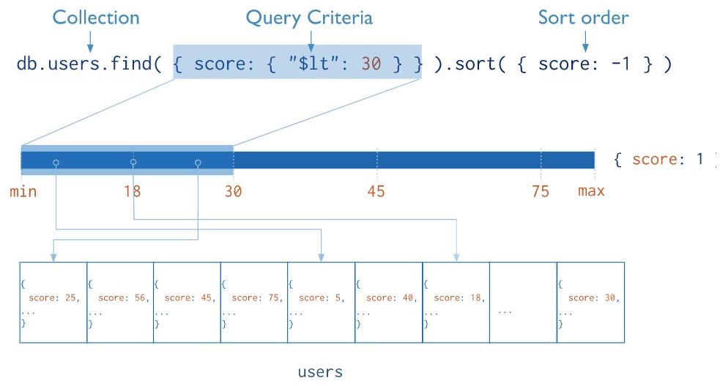
Index

Slide 19
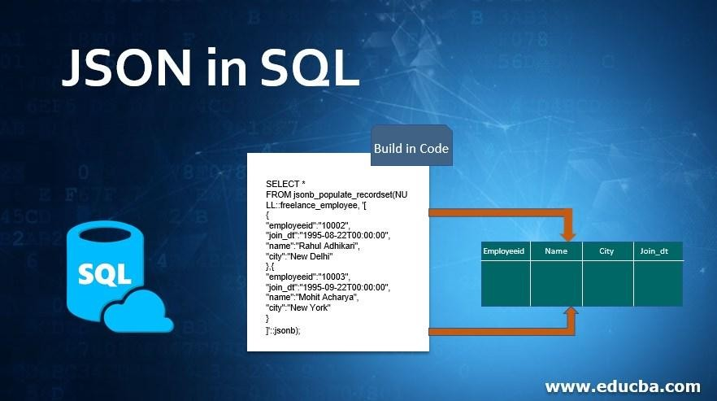
JSON and Relational Database

Slide 20
NoSQL VS’ Relational Database

Slide 21
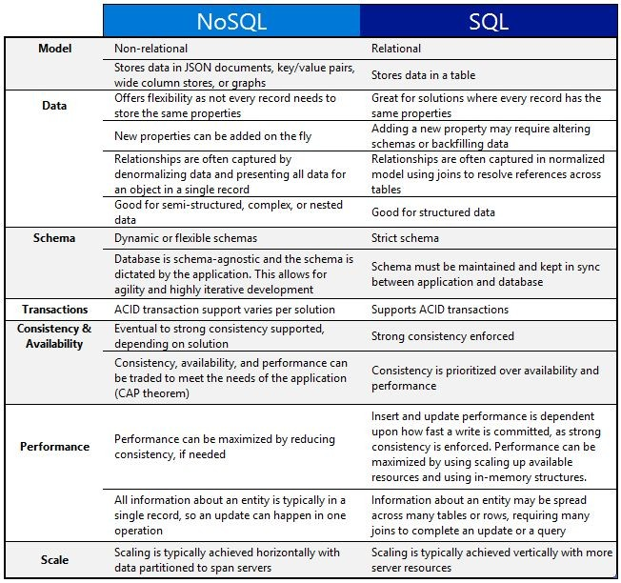

Slide 22
THANKS!
Designed by : yamu.poudel@heraldcollege.edu.np

